Slide 1
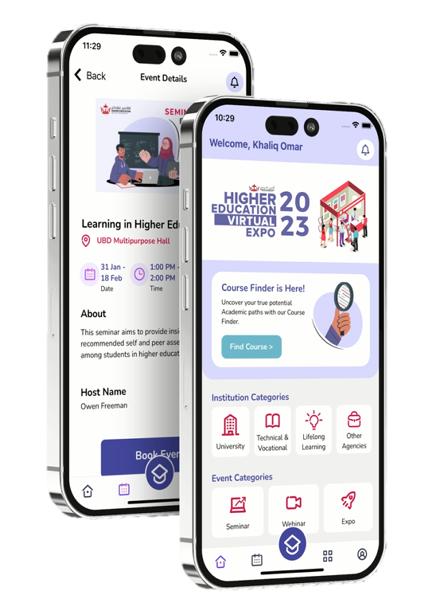

Higher Education Information Hub Plus
(HE iHub+)

Slide 2
Project Background
Project Description
Product Details:
  The Uniqueness
  Innovation
  Commercial Potential
  Local involvement
  Technical Component
  HE iHUB+ video
HE iHub+
Content

Slide 3
Research conducted (by online survey and Interview)
Research Findings
60.7% compared to 39.3% of respondents are more likely to choose Mobile Applications as the platfrom of choice
Positive response from the survey conducted amongst the students which chose Mobile App as their choice of platform in accessing information required and a growing trend of mobile app
Project was launched in Feb 2024.
HE iHub+
Project Background

Slide 4
The main objectives of this app:
As a platform for students in obtaining information on various paths to higher education and career aspirations.
To promote and introduce institutions of higher learning in the country.
Serves as a one-stop information hub for students and the public to learn more about the local higher education opportunities.
provides a tool for students and the public alike to easily explore available courses at higher education level.
To introduce higher education initiatives, achievements, events and activities to students and the public
HE iHub+

Slide 5
Course Finder
Registration
Appoitment/slot booking
General Information on Higher Education
Higher Education Institution and course directory
Event Calender
HE iHub+
About App

Slide 6
Features
Registration
Email and password
Button to Registers

Slide 7
Features
Course finder
Find course navigation button
Find my course
Qualifications
Academic Interests
Career Interests
Submit button
Course finder result
Course detail
Course detail page

Slide 8
Features
Directory
by Search
by Filter

Slide 9
Event Navigation
Features
Main Event
Webinar
Seminar
Expo

Slide 10
Features
Main Event
Search Event
Bookable Events

Slide 11
Features
Profile page
Find my course
User’s Information
App info and log out

Slide 12
The first mobile application produced by MOE
Serves as a one-stop information hub for students and the public to learn more about the local higher education opportunities.
It is not a one-off app- Potential to be developed even further
The features provides a tool for students and the public alike to easily explore available courses at higher education level.
The app also include event calender and appointment booking- to make it easier for students and the public to view the programs/events
HE iHub+
Uniqueness
Notes:
How unique is HE iHub+?

Slide 13
The app links together information from higher education institutions in Brunei into one platfrom which aims to promote further education by making the information more accessible to the public.
The app will guide the students to vision their future.
To bring in the AI innovation
HE iHub+
Innovation
Notes:
How innovative is HE iHub+?

Slide 14
HE iHub+
Local involvement
Notes:
Local involvement

Slide 15
There is potential to earn revenue through this app which could be used to further develop and maintain this app.
HE iHub+
Commercial Potentials

Slide 16
Details of software used? Operating system/server?
HE iHub+
Technical Component

Slide 17

Notes:
Promo video

Slide 19
Thank You!

